Slide 1

Data Bases 2 Project A.Y. 2020-2021 – Gamified marketing application
Gioele Mombelli
Daniele Nicolò

Slide 2
Functional specifications
An application deals with gamified consumer data collection. A user registers with a username, a password and an email. A registered user logs in and accesses a HOME PAGE where a “Questionnaire of the day” is published.
The HOME PAGE displays the name and the image of the “product of the day” and the product reviews by other users. The HOME PAGE comprises a link to access a QUESTIONNAIRE PAGE with a questionnaire divided in two sections: a section with a variable number of marketing questions about the product of the day (e.g., Q1: “Do you know the product?” Q2: Have you purchased the product before?” and Q3 “Would you recommend the product to a friend?”) and a section with fixed inputs for collecting statistical data about the user: age, sex, expertise level (low, medium high). The user fills in the marketing section, then accesses (with a next button) the statistical section where she can complete the questionnaire and submit it (with a submit button), cancel it (with a cancel button), or go back to the previous section and change the answers (with a previous button). All inputs of the marketing section are mandatory. All inputs of the statistical section are optional.
After successfully submitting the questionnaire, the user is routed to a page with a thanks and greetings message.
The database contains a table of offensive words. If any response of the user contains a word listed in the table, the transaction is rolled back, no data are recorded in the database, and the user’s account is blocked so that no questionnaires can be filled in by such account in the future.
When the user submits the questionnaire one or more trigger compute the gamification points to assign to the user for the specific questionnaire, according to the following rule:
1. One point is assigned for every answered question of section 1 (remember that the number of questions can vary in different questionnaires).
2. Two points are assigned for every answered optional question of section 2.

Slide 3
Functional specifications pt.2
When the user cancels the questionnaire, no responses are stored in the database. However, the database retains the information that the user X has logged in at a given date and time.
The user can access a LEADERBOARD page, which shows a list of the usernames and points of all the users who filled in the questionnaire of the day, ordered by the number of points (descending).
The administrator can access a dedicated application on the same database, which features the following pages
- A CREATION page for inserting the product of the day for the current date or for a posterior date and for creating a variable number of marketing questions about such product.
- An INSPECTION page for accessing the data of a past questionnaire. The visualized data for a given questionnaire include
o List of users who submitted the questionnaire.
o List of users who cancelled the questionnaire.
o Questionnaire answers of each user.
- A DELETION page for ERASING the questionnaire data and the related responses and points of all users who filled in the questionnaire. Deletion should be possible only for a date preceding the current date.

Slide 4
Technical specifications
The application should be realized with the following technologies:
1. MySQL DBMS;
2. TomEE JEE application/web server;
3. Java servlet and templating (JSP, JSTL or Thymeleaf) for the user interface;
4. EJB (stateless or stateful) for the business objects;
5. JPA for object relational mapping and transaction management;
6. Triggers and constraints for database-level business constraints and rules.

Slide 5
The application

Slide 6
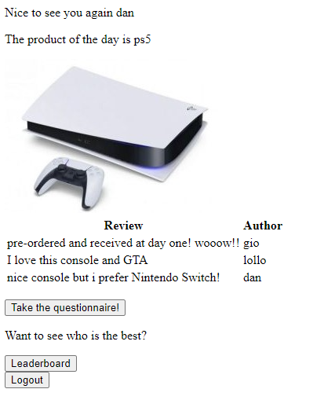
Player Home Page

Slide 7
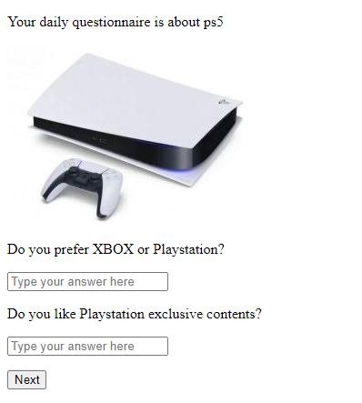
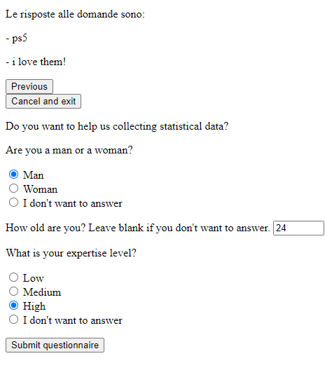
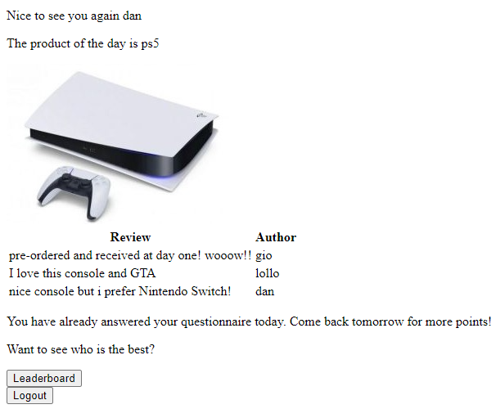
Product of the day - Questionnaire

Slide 8
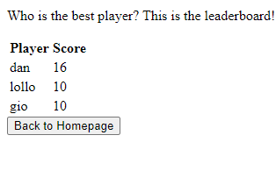
Leaderboard

Slide 9
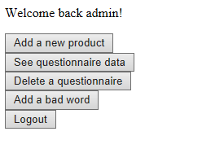
Admin Home Page

Slide 10
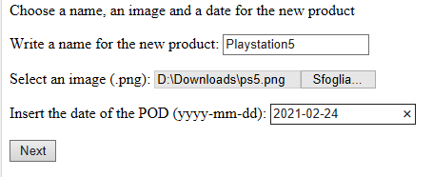
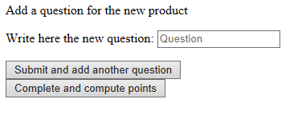
Create a new product

Slide 11
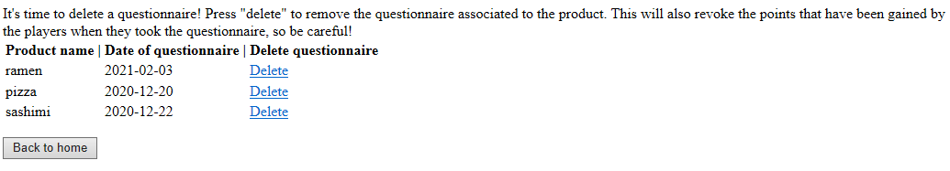
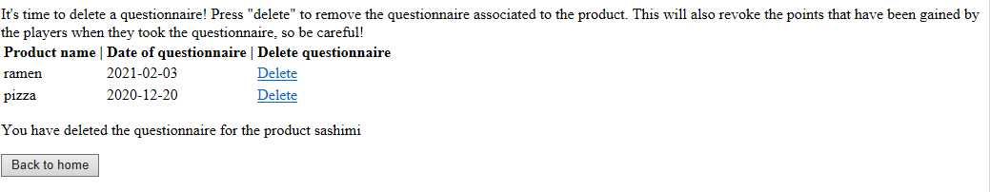
Delete a questionnaire

Slide 12
Entity-Relationship Diagram

Slide 13
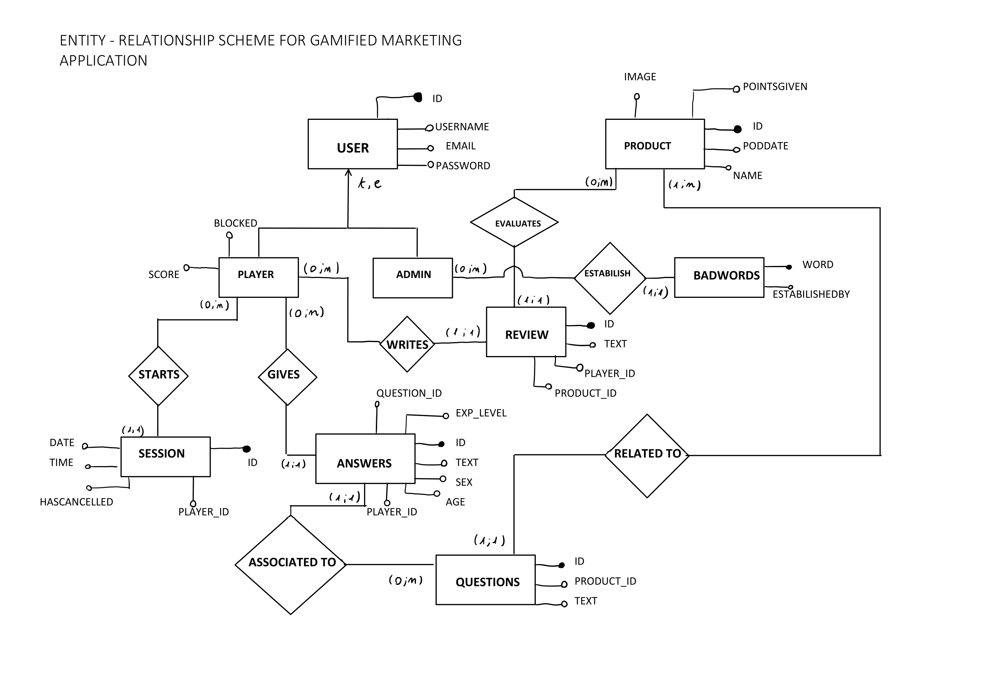

Slide 14
Logical Schema

Slide 15
CREATE TABLE player (
id int PRIMARY KEY NOT NULL AUTO_INCREMENT,
username varchar(32) NOT NULL UNIQUE,
pwd varchar(32) NOT NULL,
email varchar(32) NOT NULL UNIQUE,
score int DEFAULT 0,
blocked BOOLEAN DEFAULT FALSE
);
CREATE TABLE badwords (
word varchar(32) PRIMARY KEY,
estabilished_by varchar(32) NOT NULL
);
CREATE TABLE product (
id int PRIMARY KEY NOT NULL AUTO_INCREMENT,
name varchar(32) NOT NULL,
pointsgiven int,
image MEDIUMBLOB,
PODdate date
);

Slide 16
CREATE TABLE administrator (
id int PRIMARY KEY NOT NULL AUTO_INCREMENT,
username varchar(32) NOT NULL UNIQUE,
pwd varchar(32) NOT NULL,
email varchar(32) NOT NULL UNIQUE
);
CREATE TABLE session (
id int PRIMARY KEY NOT NULL AUTO_INCREMENT,
player_id int NOT NULL,
logdate DATE,
logtime TIME,
hascancelled BOOLEAN,
CONSTRAINT FOREIGN KEY (player_id) REFERENCES player(id) ON DELETE CASCADE ON UPDATE CASCADE
);
When a player decides to cancel the questionnaire without submitting it, the value hascancelled is set to TRUE for his/her current session.

Slide 17
CREATE TABLE review (
id int NOT NULL PRIMARY KEY AUTO_INCREMENT,
product_id int NOT NULL,
player_id int,
text varchar(2048) NOT NULL,
CONSTRAINT FOREIGN KEY (product_id) REFERENCES product(id) ON DELETE CASCADE ON UPDATE CASCADE,
CONSTRAINT FOREIGN KEY (player_id) REFERENCES player(id) ON DELETE CASCADE ON UPDATE CASCADE
);
CREATE TABLE questions (
id int NOT NULL PRIMARY KEY AUTO_INCREMENT,
product_id int NOT NULL,
text varchar(2048) NOT NULL,
CONSTRAINT FOREIGN KEY (product_id) REFERENCES product(id) ON DELETE CASCADE ON UPDATE CASCADE
);

Slide 18
CREATE TABLE answers (
id int NOT NULL PRIMARY KEY AUTO_INCREMENT,
question_id int NOT NULL,
player_id int,
text varchar(2048) NOT NULL,
sex varchar(1),
exp_level varchar(6),
age int,
CONSTRAINT FOREIGN KEY (player_id) REFERENCES player(id) ON DELETE SET NULL ON UPDATE CASCADE,
CONSTRAINT FOREIGN KEY (question_id) REFERENCES questions(id) ON DELETE CASCADE ON UPDATE CASCADE
);
When a player is deleted from the DB his answers are not removed but the player id on the answers table is set to null. It can be useful to keep the anwers for statistical reasons.

Slide 19
Relationships

Slide 20
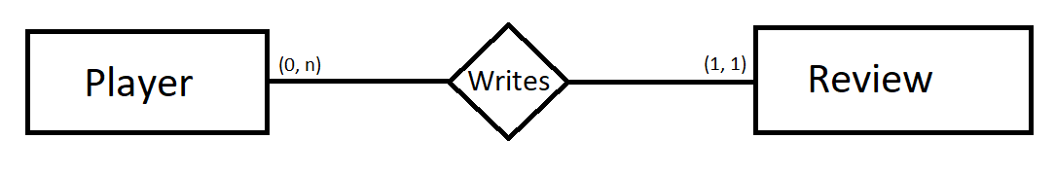


Player WRITES Review
Relationship in Player Entity
Relationship in Review Entity

Slide 21
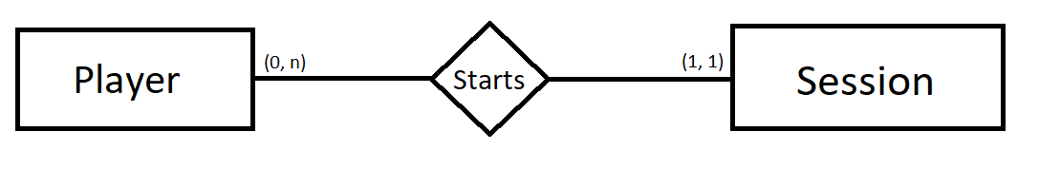


Player STARTS Session
Relationship in Player Entity
Relationship in Session Entity

Slide 22
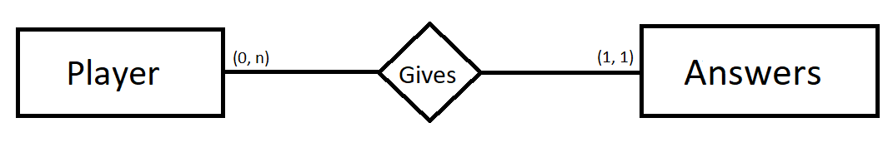


Player GIVES Answers
Relationship in Player Entity
Relationship in Answers Entity

Slide 23
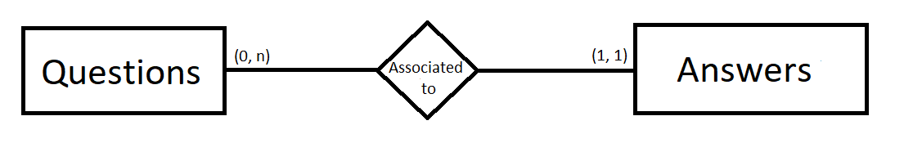


Answers ASSOCIATED TO Questions
Relationship in Questions Entity
Relationship in Answers Entity

Slide 24
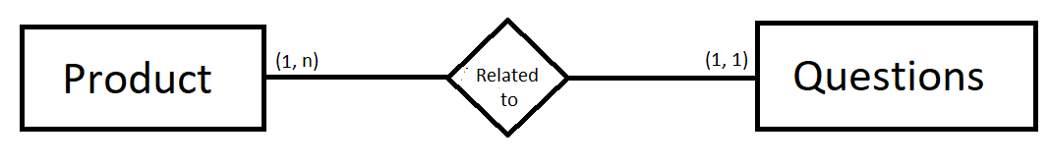


Questions RELATED TO Product
Relationship in Product Entity
Relationship in Questions Entity

Slide 25
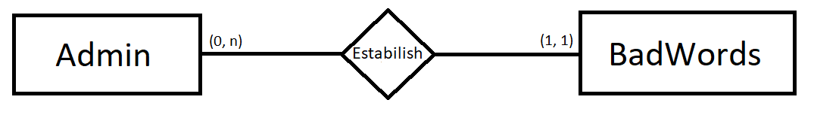


Admin ESTABILISH BadWords
Relationship in Admin Entity
Relationship in BadWords Entity

Slide 26
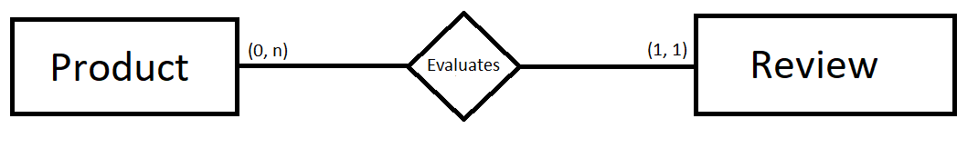


Review EVALUATES Product
Relationship in Product Entity
Relationship in Review Entity

Slide 27
Application Design Schema

Slide 28
How to read the APPLICATION DESIGN SCHEMA
On the next slide it will be shown a schema for the client application. A more readable version is given in the PDF document attached.
Black boxes: HTML page
Light blue arrows: Redirection flow
Orange boxes: Servlets
Red text: exceptions raised
Blue text: data sent to the database
Grey text: operations on the session

Slide 29
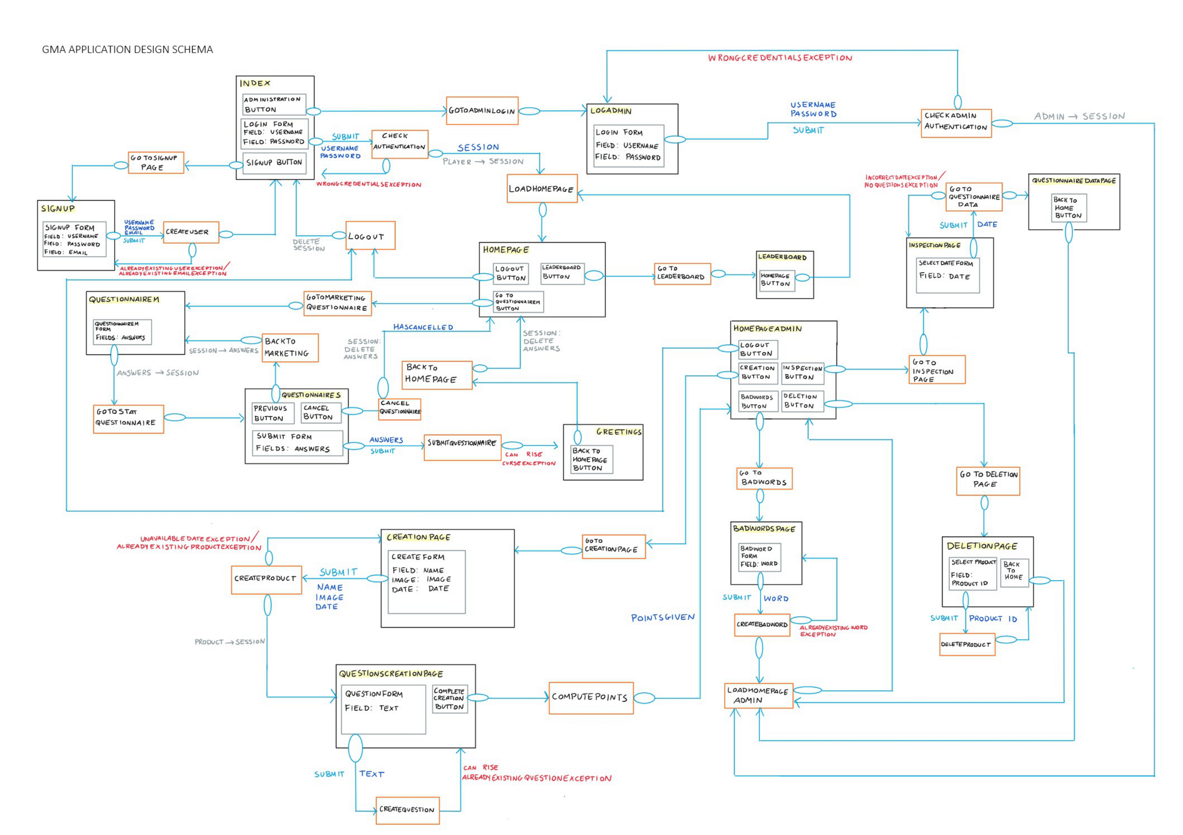

Slide 30
Components Client Side

Slide 31
COMPONENTS CLIENT SIDE - WEBPAGES
BadwordsPage.html
This page allows the administrator to submit a new bad word that must be censored.
CreationPage.html
This page allows the administrator to create and insert a new product in the system
DeletionPage.html
This page allows the administrator to delete the questionnaire associated to a product.

Slide 32
COMPONENTS CLIENT SIDE - WEBPAGES
Greetings.html
This page shows a greeting message after a user has submitted the questionnaire.
HomePage.html
This page shows the product of the day, the reviews and allows the user to go to the questionnaire of the day.
HomePageAdmin.html
This page allows the admin to access the various pages for create products and badwords and for inspecting the results.

Slide 33
COMPONENTS CLIENT SIDE - WEBPAGES
InspectionPage.html
This page asks the admin for a date in order to retrieve the questionnaire associated to the product of that day.
Leaderboard.html
This page shows the leaderboard to the user.
Logadmin.html
Login form dedicated to the administration.

Slide 34
COMPONENTS CLIENT SIDE - WEBPAGES
QuestionnaireDataPage.html
This page shows the questionnaire answers and other information for the selected product.
QuestionnaireM.html
This page shows the marketing questions of the questionnaire and allows the user to answer them.
QuestionnaireS.html
This page shows the statistical questions of the questionnaire and allows the user to answer them.

Slide 35
COMPONENTS CLIENT SIDE - WEBPAGES
QuestionsCreationPage.html
This page allows the admin to create various questions for the product of the day.
SignUp.html
This page allows a new user to register in the application.
index.html
This page is the entry point of the client application. It contains the login form and a button to access the admin login.

Slide 36
COMPONENTS CLIENT SIDE - SERVLETS
BackToHomePage:
This servlet redirects the user to the homepage. It also clears the answers from the session.
BackToMarketing:
This servlet redirects the user to the marketing questionnaire. It restores the previous inserted questions from the session into the fields of the form, so that the user can modify them.
CancelQuestionnaire:
This servlet redirects the user to the homepage, and is called when the user does not want to submit the questionnaire. It also clears the answers saved in the session of the player.

Slide 37
COMPONENTS CLIENT SIDE - SERVLETS
CheckAdminAuthentication:
This servlet checks the credentials of the admin, and if they are correct redirects the administrator to its dedicated homepage.
CheckAuthentication:
This servlet checks the credentials of the user, and if they are correct redirects the user to the homepage.
Computepoints:
This servlet calls the service classes that are needed to compute the points given by a product associated to the number of its marketing questions. It also redirects the admin to the homepage.

Slide 38
COMPONENTS CLIENT SIDE - SERVLETS
CreateBadword:
This servlet calls the service classes that are needed to insert a new badword into the database. It raises an exception if the badword is already in the system.
CreateProduct:
This servlet calls the service classes that are needed to insert a new product into the system. This servlet only adds the name, the image and the date of the product to the database. It then redirects the admin to a page where the questions of the questionnaire can be written. It also saves the product id in the session in order to allow the next page to add the questions to the correct product.
CreateQuestion:
This servlet calls the service classes that are needed to insert a new question associated to the product into the system. It brings the admin back to the same page in order to allow the insertion of multiple questions.

Slide 39
COMPONENTS CLIENT SIDE - SERVLETS
CreateUser:
This servlet calls the service classes that are needed to create a new user. It is called by the signup page and redirects to the index where the login can be performed.
DeleteProduct:
This servlet calls the service classes that are needed to delete the questionnaire associated to a product. It then redirects to the same page where an updated list of products available for deletion is shown.
GoToAdminLogin:
This servlet redirects to the login page for the administrator.
GoToBadwords:
This servlet redirects to the page for inserting a new badword.

Slide 40
COMPONENTS CLIENT SIDE - SERVLETS
GoToCreationPage:
This servlet redirects to the page for creating a new product.
GoToDeletionPage:
This servlet redirects to the page for deleting the questionnaire related to a product.
GoToInspectionPage:
This servlet redirects to the page for choosing the date in order to inspect the questionnaire results.
GoToLeaderboard:
This servlet redirects to the page that shows the leaderboard.
GoToMarketingQuestionnaire:
This servlet redirects the user to the marketing questionnaire associated do the product of the day.

Slide 41
COMPONENTS CLIENT SIDE - SERVLETS
GoToQuestionnaireData:
This servlet redirects to the page that shows the questionnaire information for the chosen product.
GoToSignupPage:
This servlet redirects to the page that allows a new user to register into the system.
GoToStatQuestionnaire:
This servlet redirects to the statistical questionnaire page. It saves in the session the answers of the marketing questionnaire, so that they can be retrieved if the user wants to go back and change them.

Slide 42
COMPONENTS CLIENT SIDE - SERVLETS
LoadHomePage:
This servlet loads the home page in order to show it to the user. It calls the service classes that are needed to retrieve the product of the day with the associated reviews. It also prevents the user to take the questionnaire if he has been banned or has already taken the daily questionnaire.
LoadHomePageAdmin:
This servlet redirects to the home page for the administration panel.
Logout:
This servlet performs the logout: it clears the session for the user and redirects to the home page.
SubmitQuestionnaire:
This servlet calls the service classes that are needed to insert into the system the answers of the user.

Slide 43
SERVLET EXTRACT - loadhomepage
It will be shown the code for the loadhomepage Servlet. This Servlet handles the dynamic generation of the homepage by retrieving the information about the product of the day. It also performs some checks in order to enable or disable the button for taking the questionnaire. If the player is banned or has already taken the questionnaire, the button is disabled and an error message is displayed instead.

Slide 44
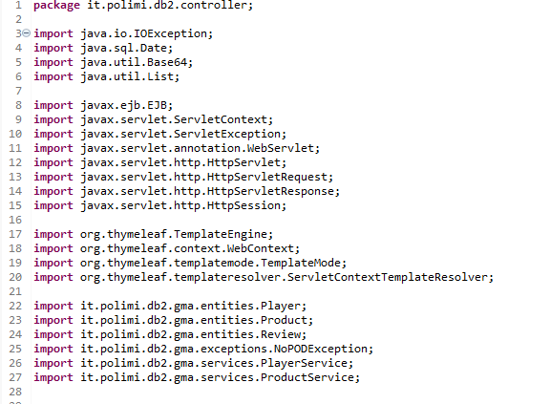
SERVLET EXTRACT - loadhomepage
Series of imports needed to implement
the functionalities.

Slide 45
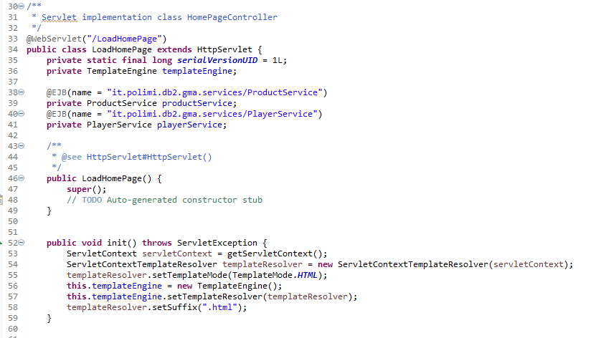
SERVLET EXTRACT - loadhomepage
Here is shown the instantiation of the
Business components, at lines 39 and 41.

Slide 46
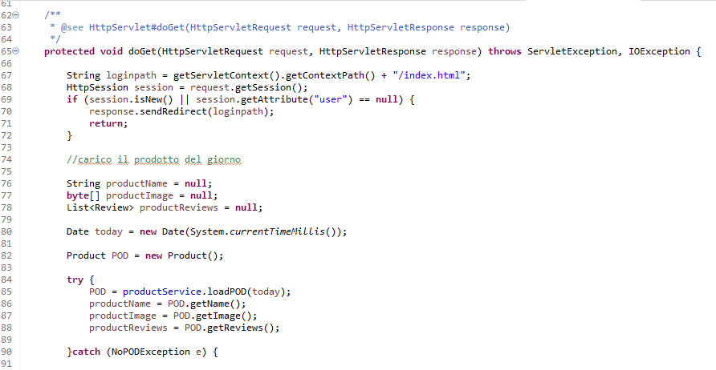
SERVLET EXTRACT - loadhomepage
Here is shown how the servlet checks the authentication of the user by trying to retrieve the attribute «user» from the session. It is also shown the retrieve of the POD by calling the service loadPOD at the line 85.

Slide 47
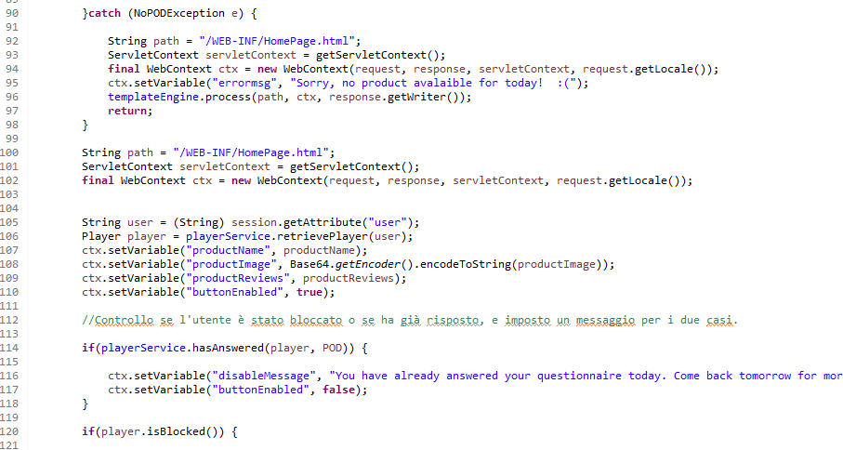
SERVLET EXTRACT - loadhomepage
At the line 90 is handled the eventual
absence of a product of the day.
The button for taking the questionnaire is disabled at the line 114
if the player has already answered. The variable «buttonEnabled»
is later checked in the HTML. The same goes in the case of ban.

Slide 48
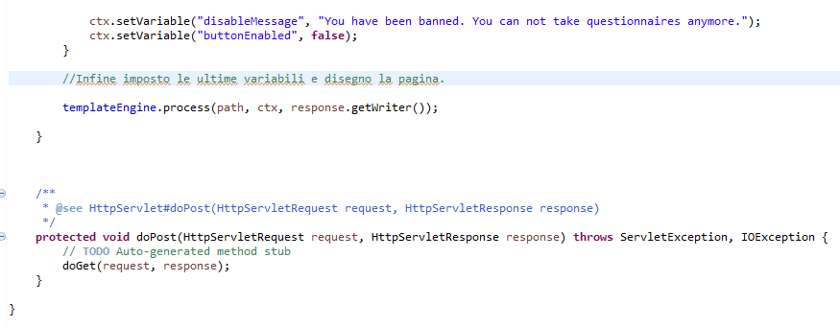
SERVLET EXTRACT - loadhomepage

Slide 49
Business Components

Slide 50
BUSINESS COMPONENTS - SERVICES
AdministratorService:
This business class offers the method to check the authentication of the administrator.
-checkAdminAuthentication(username, password)
AnswerService:
This business class offers various methods to handle the answers.
- checkBadWords(answer): check if an answer contains a badword.
submitAnswers(answers list, sex, explevel, age, user): this method inserts the answers given by a player (both the statistical and the marketing ones) into the system and gives the player the points dynamically computed based on the answers.
BadwordService:
This business class offers the method to insert a new badword in the system.
- addBadword(badword)

Slide 51
BUSINESS COMPONENTS - SERVICES
PlayerService:
This business class offers various methods to handle the players.
- checkAuthentication(username, password): checks if the credentials are correct
- retievePlayer(username): this is used only if the player is already authenticated. It is used to retrieve the Player object.
- createPlayer(username, password, email): this adds a new player into the system. It is used when a player register.
- blockUser(player): this method blocks a player that has cursed in its answers.
- getPlayerPODAnswers(player, POD): this method retrieves the answers that a player has given to the questionnaire of a specific POD.
- hasAnswered(Player, POD): this method returns true if the player has answered to a specific POD.
- getLeaderboardPlayers(POD): this method returns all the players that have answered to a specific POD.

Slide 52
BUSINESS COMPONENTS - SERVICES
ProductService:
This business class offers various methods to handle the products.
- loadPOD(date): retrieves the POD associated to a choosen date.
- createPOD(POD): inserts into the system the name, the image and the date of a new product.
- addPoints(POD): this assigns to a product the points that such product gives if the player answers its marketing questions. This does not take account of the optional points associated to the statistical questions.
- getProductsForDeletion(Date): this retrieves the list of products that are suitable for the deletion of the questionnaire.
- deleteQuestionnaire(POD): this method deletes the questionnaire associated to the product and fixes the points for the players involved.
- checkDate(Date): this method checks if the product associated to the given date has questions associated to it.

Slide 53
BUSINESS COMPONENTS - SERVICES
QuestionService:
This business class offers the method to add a question into the system.
- addQuestion(question)
SessionService:
This business class offers the methods to handle the record of the session.
- createSession(Player): creates a new session associated to the player.
- setSessionCancelled(Player): called when the player cancels its questionnaire without submitting it. This method sets the flag that tracks the cancellation in the current session.
- getPlayersWhoCancelled(Date): this retrieves the players that have cancelled the questionnaire in a specific date.

Slide 54
BUSINESS COMPONENTS EXTRACTS
In the following slides there will be a focus on some business components’ methods by showing the source code and providing some comments.

Slide 55
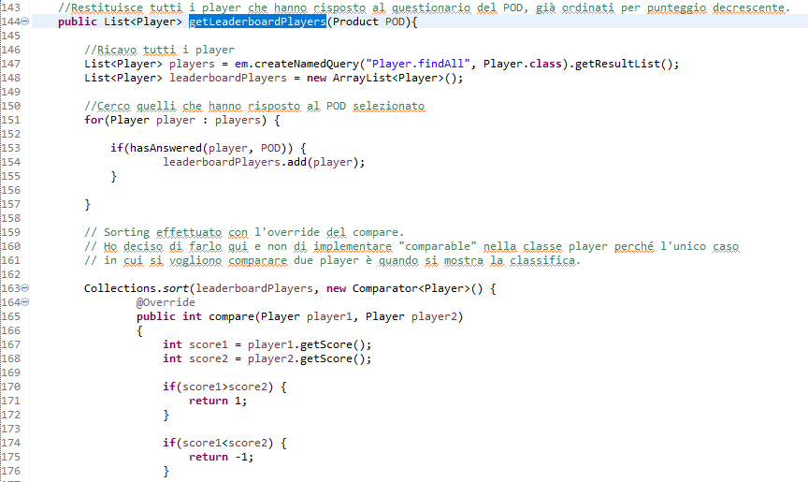
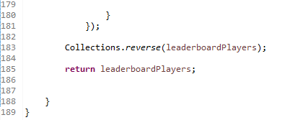
BUSINESS COMPONENT EXTRACT Method getLeaderboardPlayers from PlayerService
A NamedQuery is used in order to retrieve all the players at the line 147. Then we select only the ones that answered the questionnaire of the day at line 151.
At the line 163 the players are sorted
by the score and an ordered list is returned

Slide 56
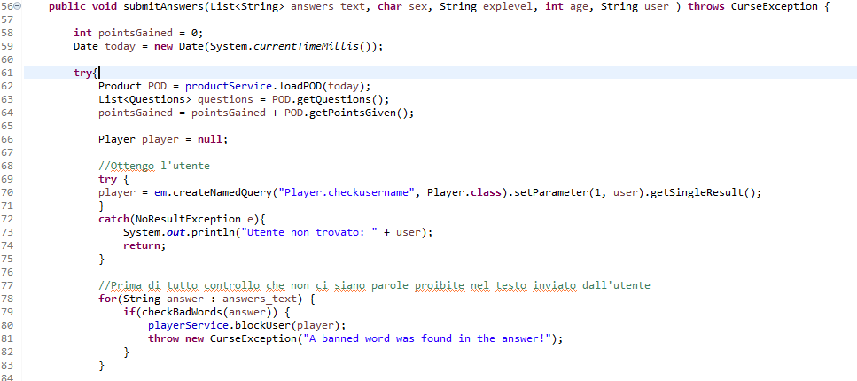
BUSINESS COMPONENT EXTRACT Method submitAnswers from AnswerService
The variable pointsGained contains the points related to the marketing section that the questionnaire gives to the player.
The points related to the statistical section will be dynamically computed later.
At the line 78 is performed the check on the words used by the player, in order to avoid the submission if a banned word is found.

Slide 57
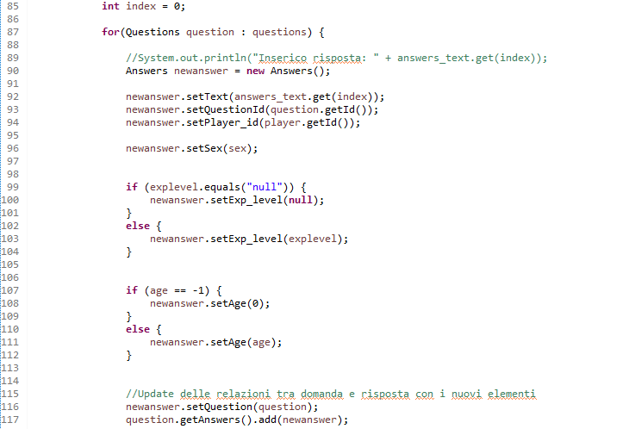
BUSINESS COMPONENT EXTRACT Method submitAnswers from AnswerService
If this point is reached, the answer is clear from banned words and is submitted to the system.
There is a special check on the values of the statistical section: the default values that the web page sends are «U» for the sex, «null» for the expertise level and -1 for the age. If the user does not give his/her answers there, the values for expertise level and age must be converted in a value coherent to the one that the rest of the application expects.

Slide 58
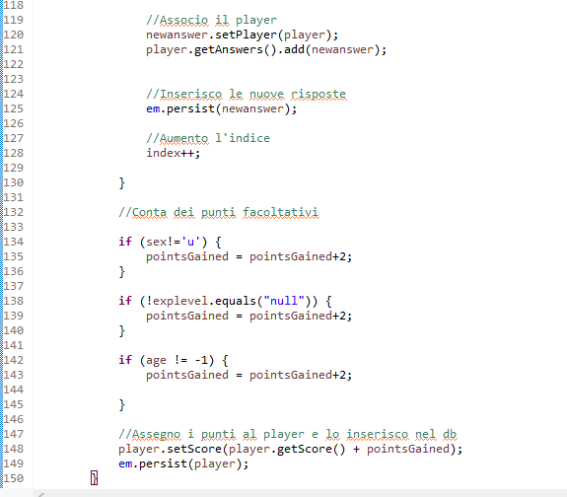
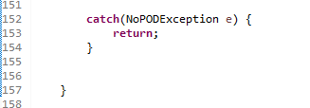
BUSINESS COMPONENT EXTRACT Method submitAnswers from AnswerService
At the line 132 starts the computation for the points of the statistical section. If the player has given answers to each one of the questions the related points are added to the count pointsGiven. At the end of the procedure the points are assigned to the player and the entitymanager is called.

Slide 59
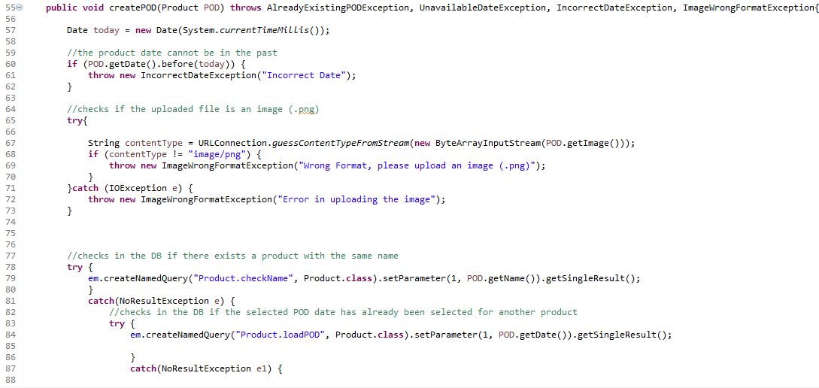
BUSINESS COMPONENT EXTRACT Method createPOD from ProductService
The first part of the method checks for the correctness of the date (it must not be a past one) and the format of the image. It also checks if the database already contains a product with the same name and if the choosen date is already assigned to a product.

Slide 60
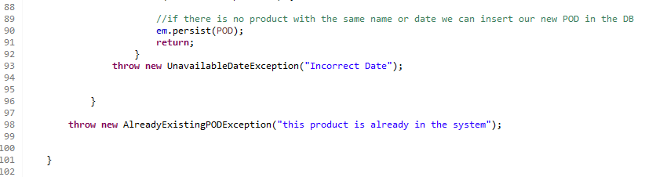
BUSINESS COMPONENT EXTRACT Method createPOD from ProductService
If the checks are good, the EM is called and the product is persited.

Slide 61
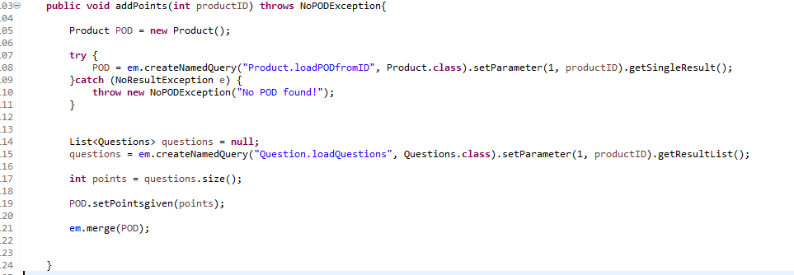
BUSINESS COMPONENT EXTRACT Method addPoints from ProductService
Since every product gives a fixed quantity of points based on the number of mandatory marketing questions associated to it, it is possible to compute their amount by simply checking the size of the list of questions associated to it (line 17).

Slide 62
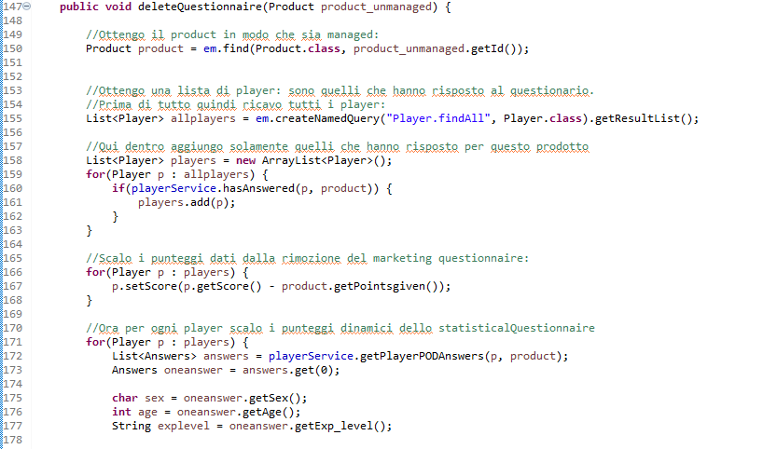
BUSINESS COMPONENT EXTRACT Method deleteQuestionnaire from ProductService
The deletion of the questionnaire has several effects on the application. When the questionnaire of a product is selected for the deletion, first of all there is the need to compute how much points the players will lose. By using the hasAnswered method it is possible to find the users that answered the questionnaire.
At the line 167 the points for the marketing questionnaire are removed, and at the line 171 is performed the computation of the statistical questions points that each player loses.

Slide 63
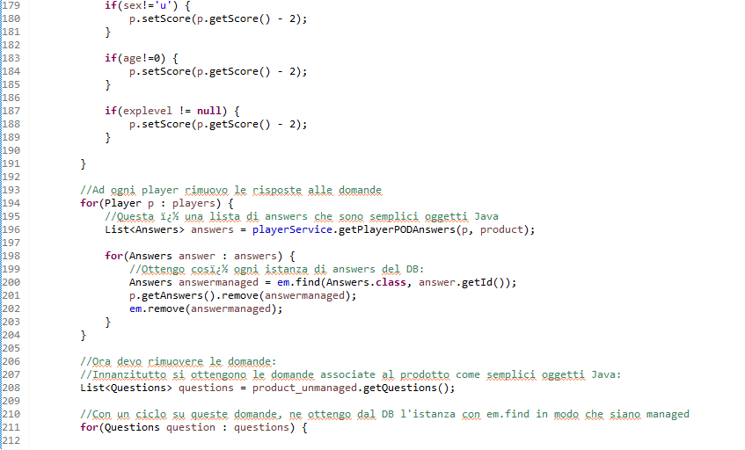
BUSINESS COMPONENT EXTRACT Method deleteQuestionnaire from ProductService
At the line 194 starts a loop that removes the association between the player and its questions.
At the line 211 starts the loop that removes the questions from the questions table of the database.

Slide 64
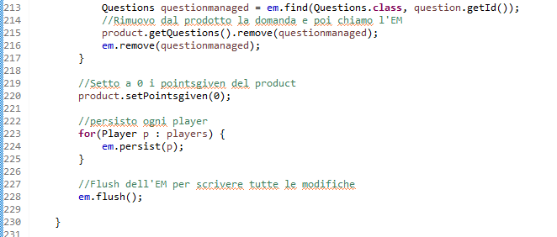
BUSINESS COMPONENT EXTRACT Method deleteQuestionnaire from ProductService
Since the product does not have a questionnaire anymore, the points that it would give are set to 0 in order to mantain the coherence with the way the points are computed.
In the end we persist the players and flush the EM.

Slide 65
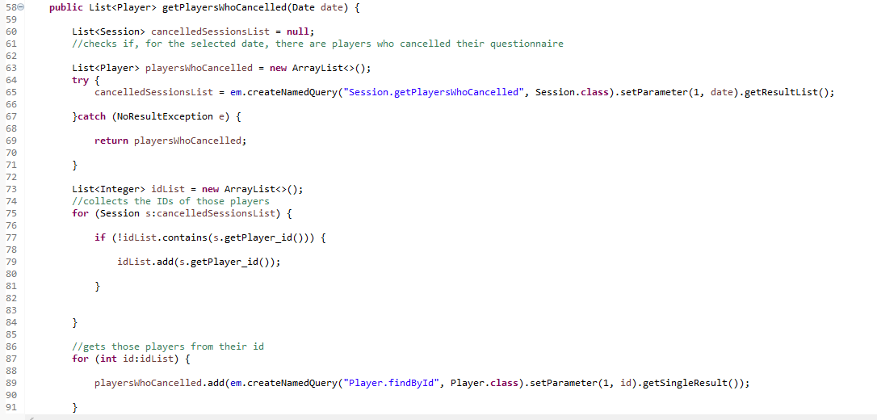
BUSINESS COMPONENT EXTRACT Method getPlayersWhoCancelled from ProductService
At the line 65 a NamedQuery is performed in order to retrieve from the database the list of all the sessions where a player has cancelled the questionnaire without submitting it.
By performing a loop on the IDs of those players, we retrieve them from the DB and we add them to a list.

Slide 66
Some significant HTML

Slide 67
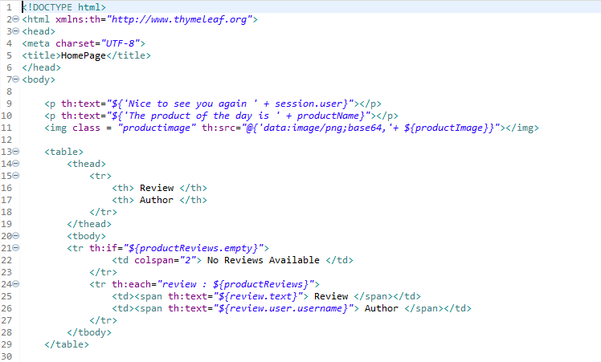
Home Page
If there aren’t reviews about the product of the day the message ‘No Reviews Available’ is shown
(lines 21-22).

Slide 68
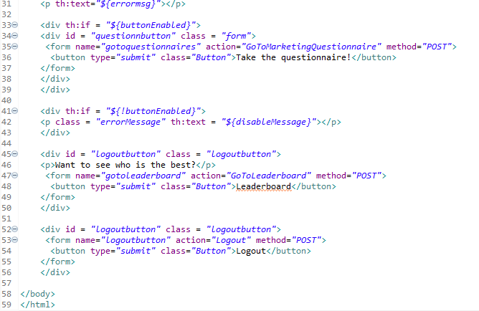
Home Page pt.2
The user can take the questionnaire of the Product of the Day only one time in a day. If he has already answered, the button to go to the questionnaire is disabled (lines 33-43)

Slide 69
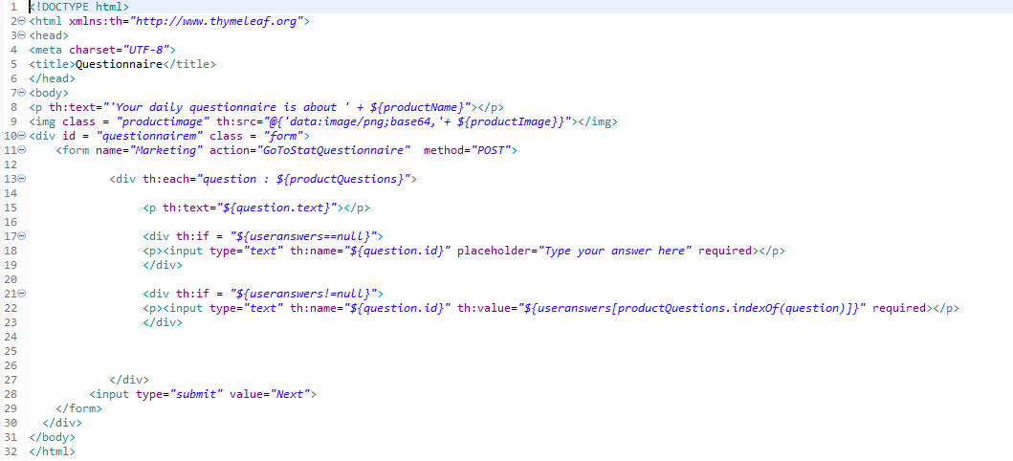
Marketing Questionnaire Page
The user has the possibility to switch from the marketing questionnaire to the statistic questionnaire and then go back without losing his answers about the first one questionnaire.
The system retrieves the user’s previous answers from his session (lines 17-23)

